Slide 1

PARKsite PROJECT PROPOSAL
William Jefferson Mondol, Shanjidul Hasan Shajid,
Fardin Ahsan Shafi, Anannya Preeta

Slide 2

TABLE OF CONTENTS
01
05
02
06
03
04
History
Opportunities
Research
Techniques
Objectives
PARKsite
Problems
07
Prototype UI
Solutions
08
Future Plans

Slide 3
01
HISTORY OF THE PROJECT

Slide 4

HISTORY
The formation of our project idea arose from a critical observation of a prevalent issue in Bangladesh. Our project idea deals with the following :
Observation of Prevalent Issue
Unorganized Parking Practices
Traffic Issues and Causes

Slide 5
02
OBJECTIVES OF THE PROJECT

Slide 6
OBJECTIVES
Our aim
The goal
We aim to solve the issue of traffic congestion by creating an innovative parking solution. Our focus is on utilizing underutilized garages and improving parking practices to reduce congestion's negative effects, enhancing commuting experiences in Dhaka and beyond.
Our project aims to ease traffic congestion through a user-friendly, secure parking solution for vehicle owners. We also intend to help small garage owners earn extra income and tackle parking space challenges.

Slide 7
PROJECT TIMELINE
BRAINSTORM PROJECT IDEA
ARCHITECTURE DESIGN
RESEARCH & DATA-COLLECTION
RE-EVALUATE PROJECT IDEA
ACQUIRING SOFTWARE ITEMS
FRONTEND DEVELOPMENT
BACKEND DEVELOPMENT
TESTING

Slide 8
03
PROBLEMS OF THE PROJECT

Slide 9
PROBLEMS
Underutilized Garage Spaces
Unorganized Parking Practices
Safety and Security
Scarcity of free,
convenient Parking Spaces

Slide 10
04
SOLUTIONS OF THE PROJECT

Slide 11
SOLUTIONS
Garage-Sharing
Mitigating Congestion
Optimizing Availability
Secure Parking Solution

Slide 12
05
OPPORTUNITIES OF THE PROJECT

Slide 13
OPPORTUNITIES
The various opportunities that will benefit the users of our system and us, are:
Centralized Parking Solution
Passive Income for Garage Owners
Supplementing Income for Supervisors/Guards
Enhanced Vehicle Safety
Flexibility and Customizability
PARKsite

Slide 14
06
RESEARCH TECHNIQUES

Slide 15
3
7
30
Stories
Interviews
PARKsite
Survey Questionnaire Responses

Slide 16
SURVEY QUESTIONNAIRE FINDINGS
 | Vehicle Owner | Garage Owner | Supervisor
Responses | 60% | 26.7% | 13.3%
Passive Income | - | 87.5% | 100%
Platform Interest | 55.8% | 87.5% | 100%
Hours Available | - | 16 hours | 12 hours
Parking Hassle | 83.3% | 69.3% | -
Current Reliability | 23% | - | 85.2%

Slide 17
07
PROTOTYPE UI

Slide 18
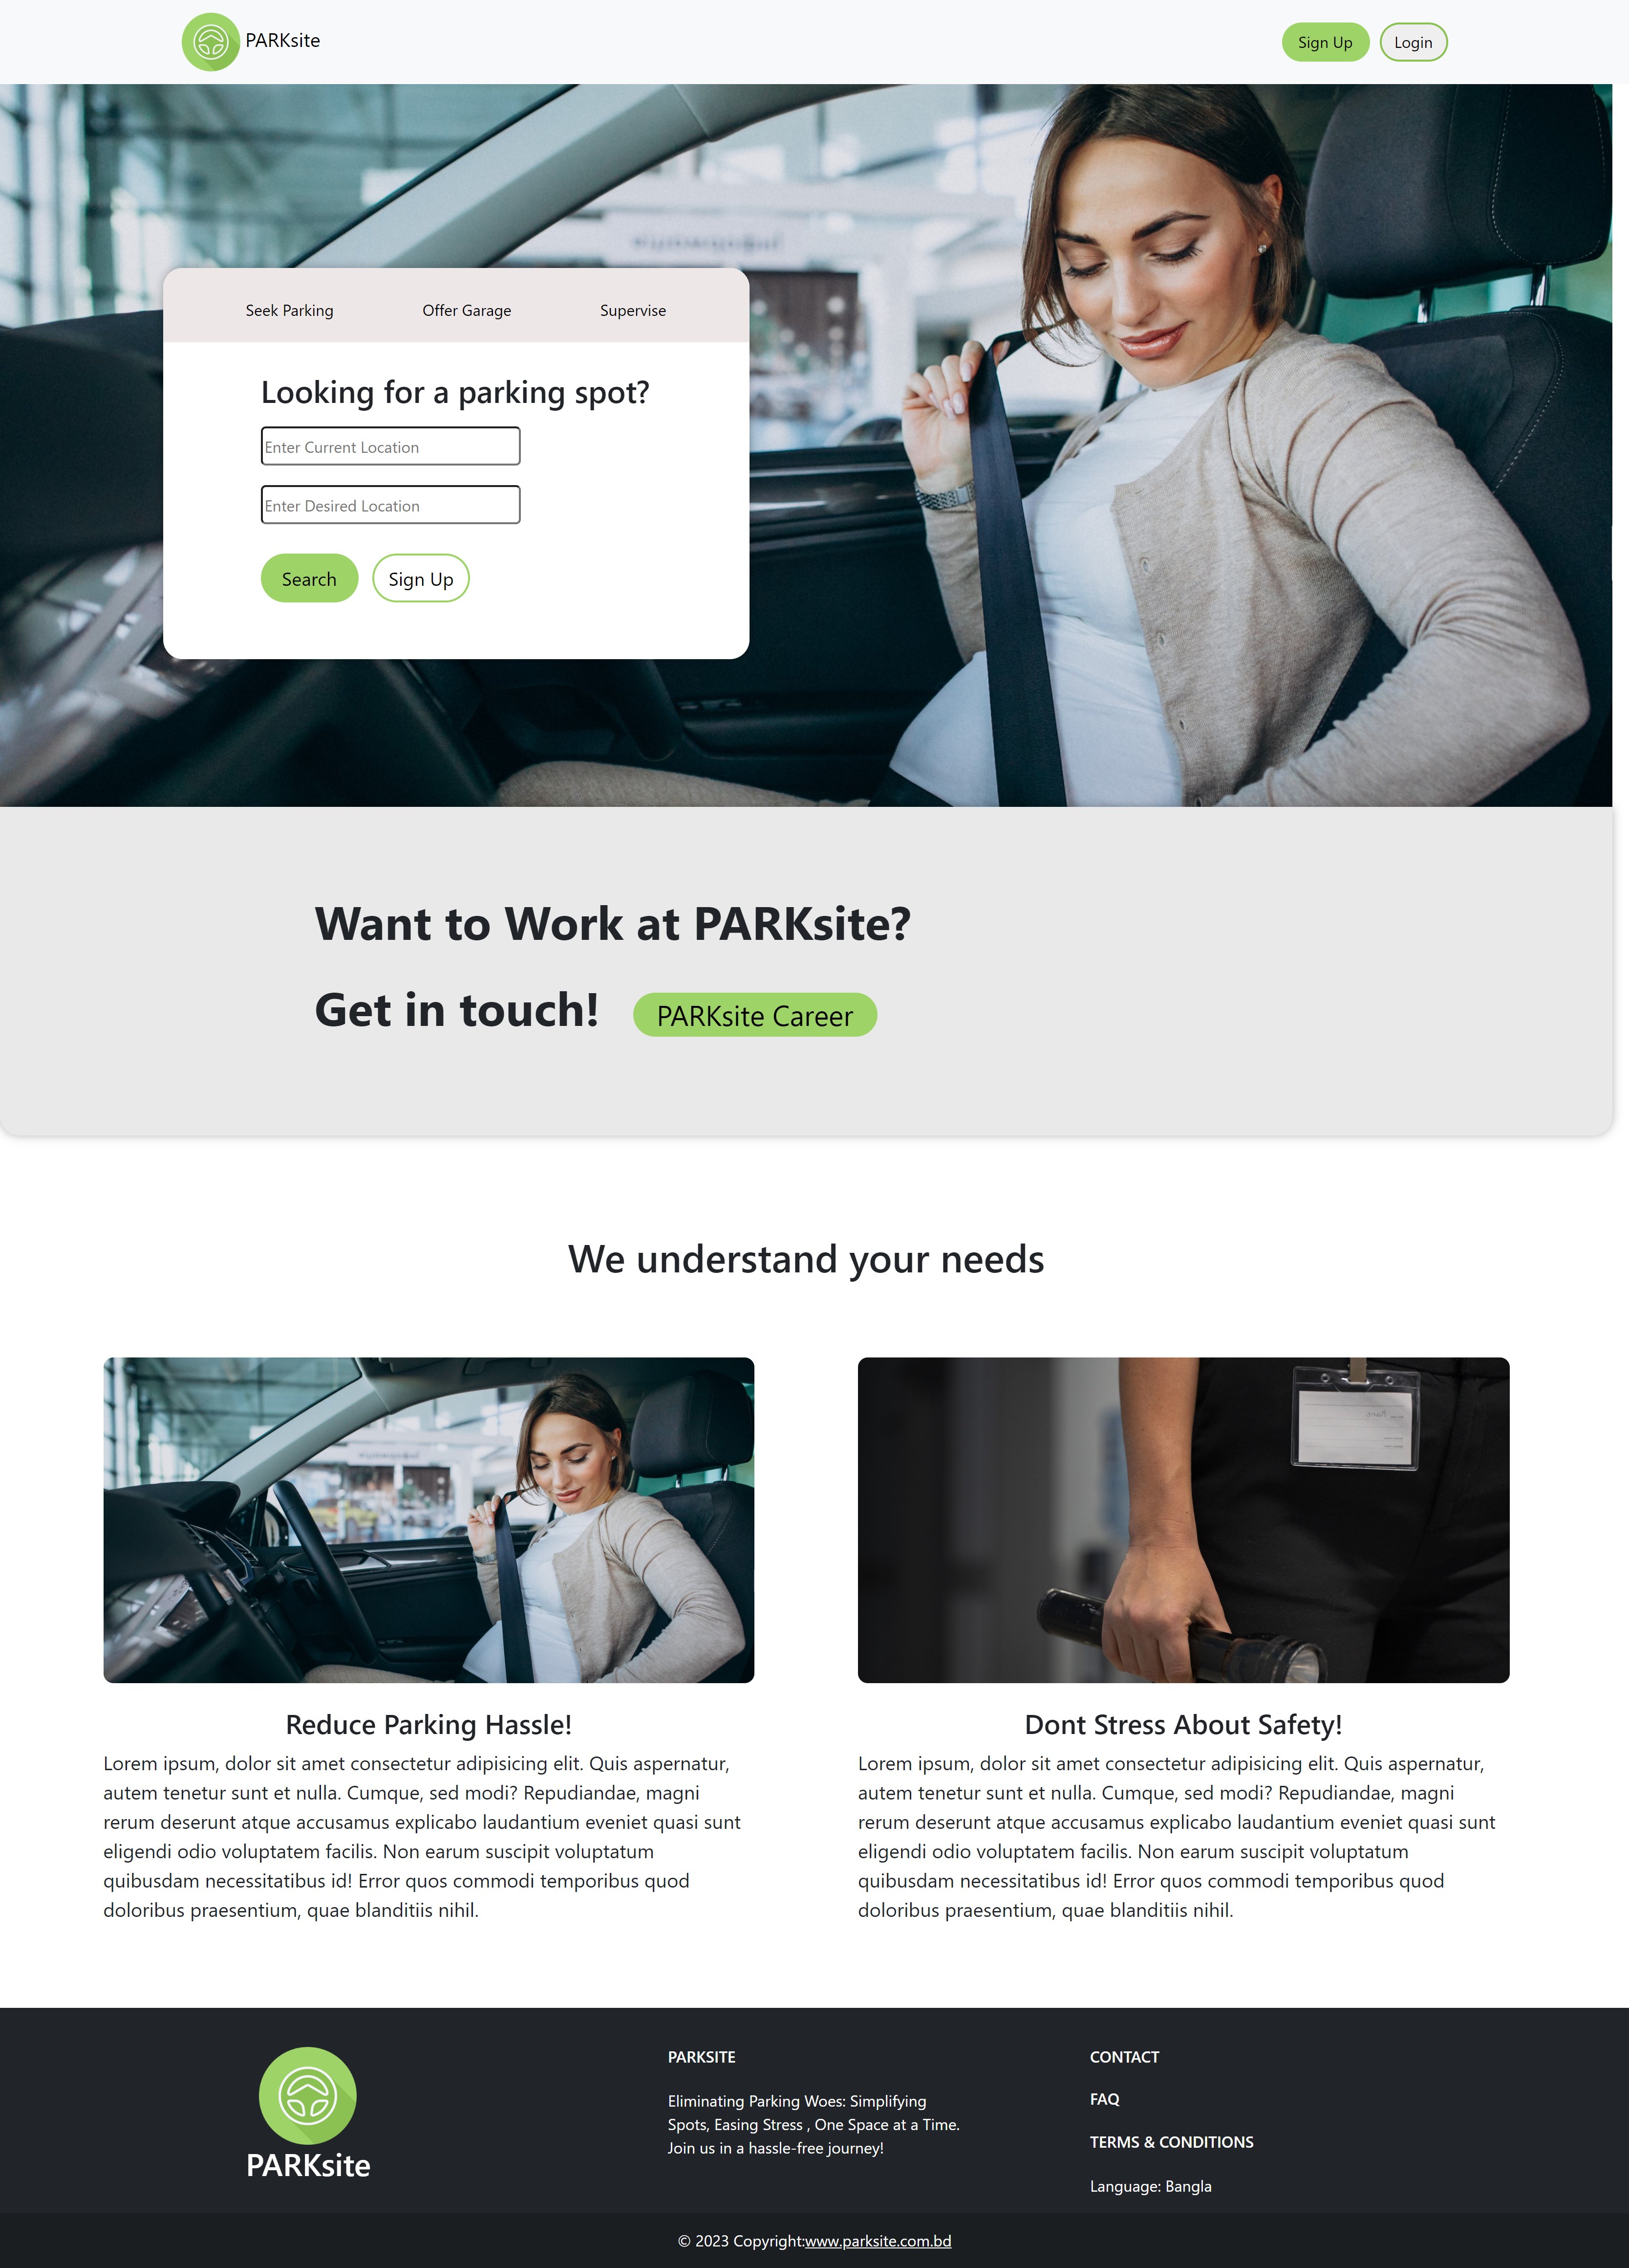
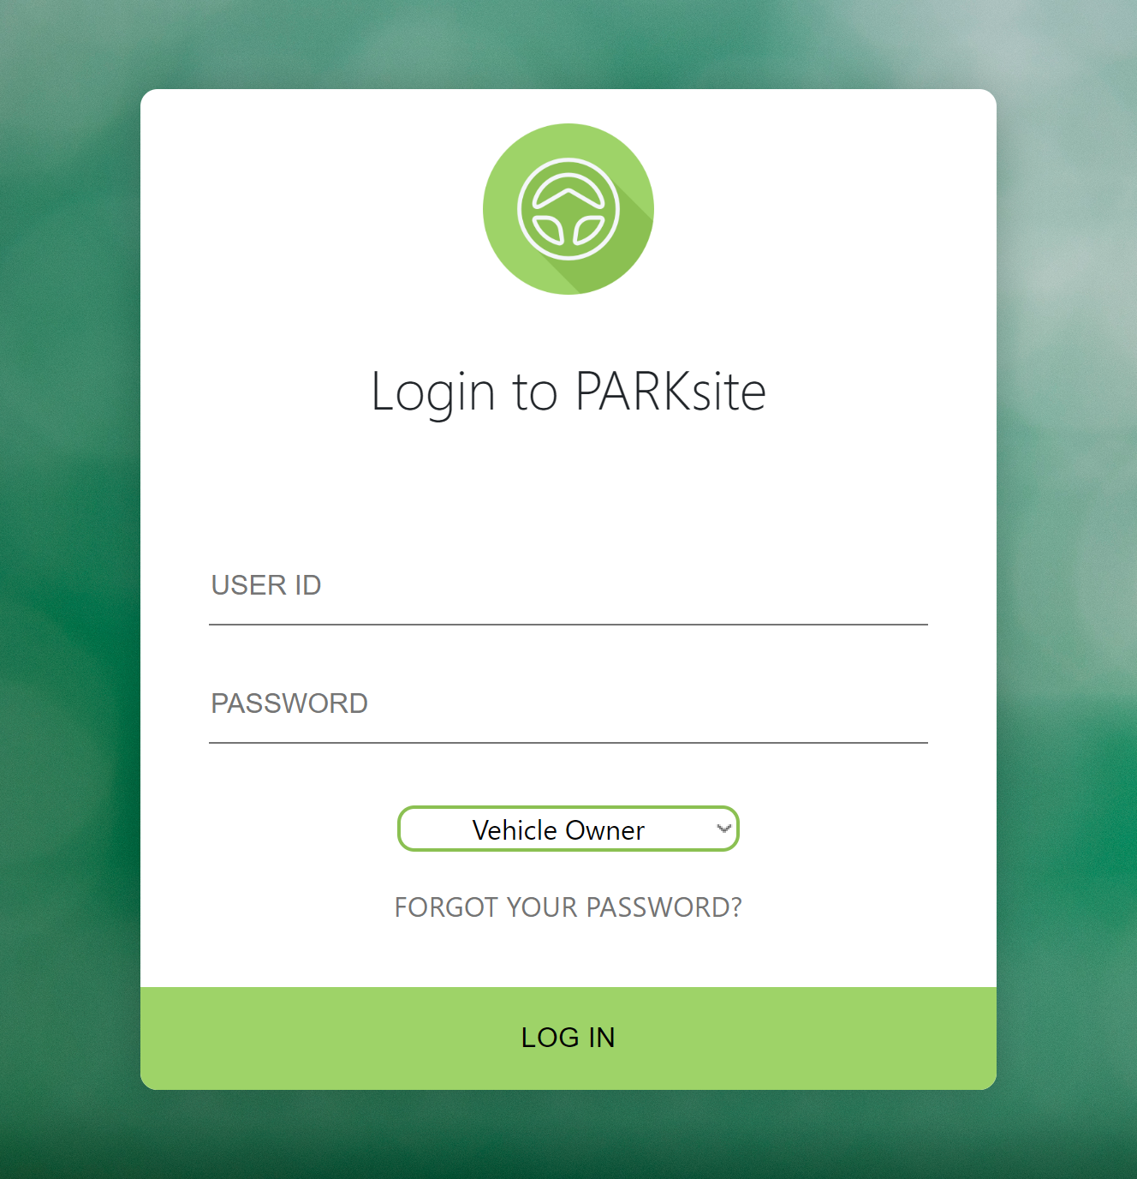
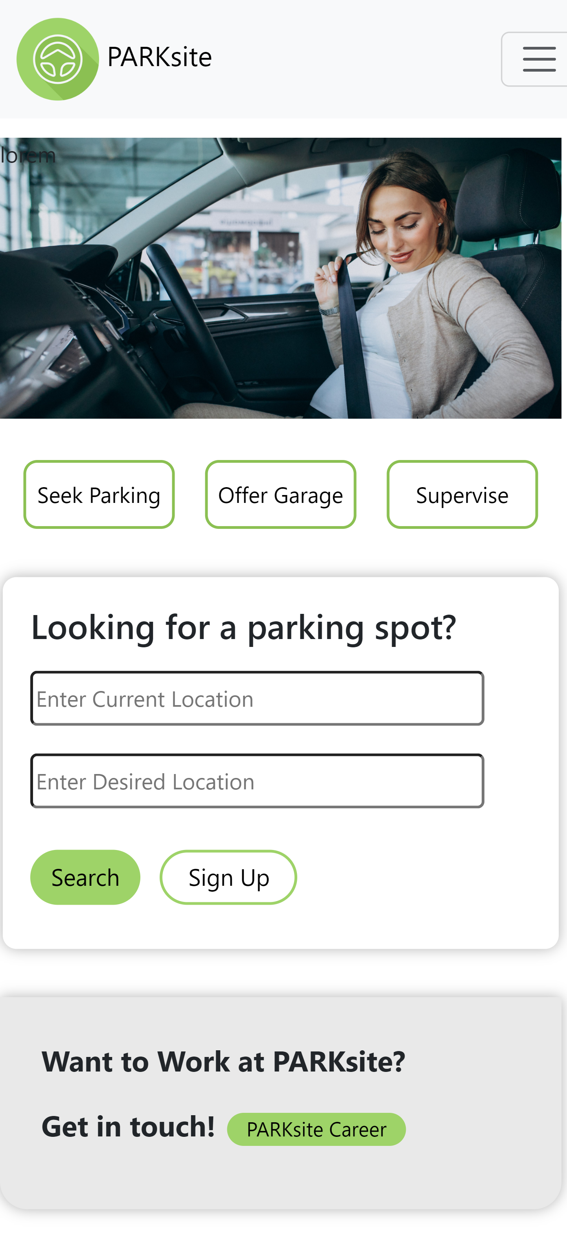
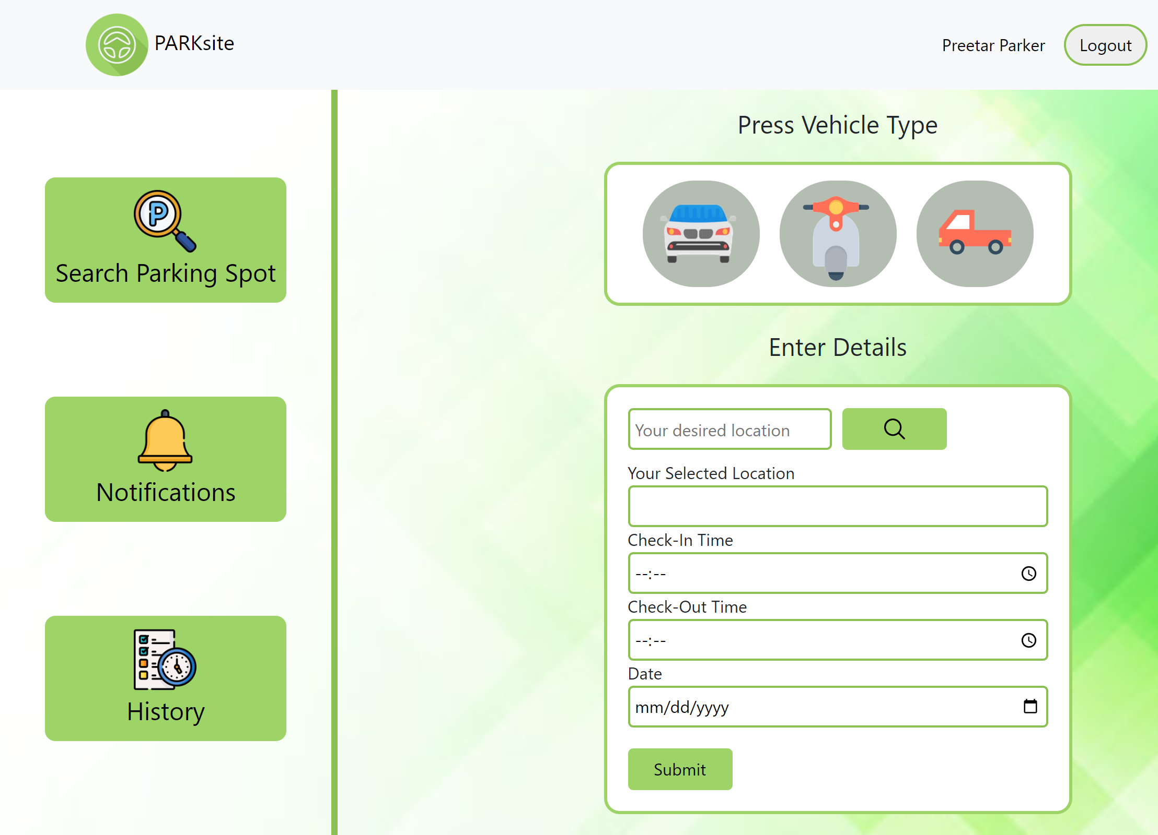

Slide 19
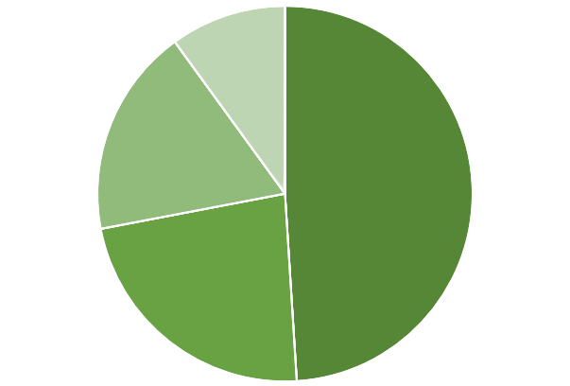
PROJECT LANGUAGES
HTML
PHP
CSS
JS

Slide 20
08
FUTURE PLANS

Slide 21

FUTURE PLANS
Regulating Parking Prices
Diverse Rental Options
Traffic Management Solutions
Smart Urban Planning
Cashless Payment System

Slide 22
THANKS!
Do you have any questions?
Independent University, Bangladesh

